Slide 1
Artificial Intelligence: – Adversarial Search and Games
Original Slides by: Tom Lenaerts
Institut de Recherches Interdisciplinaires et de Développements en Intelligence Artificielle (IRIDIA)
Université Libre de Bruxelles
Adapted for Edinburgh Napier by Ben Paechter

Slide 2
Outline
What are games?
Optimal decisions in games
Which strategy leads to success?
α-β pruning
Games of imperfect information
Games that include an element of chance

Slide 3
What are and why study games?
Games are a form of multi-agent environment
What do other agents do and how do they affect our success?
Cooperative vs. competitive multi-agent environments.
Competitive multi-agent environments give rise to adversarial problems a.k.a. games
Why study games?
Agents that play games are useful for entertainment
Interesting subject of study because they are harder than they look
Easy to represent and agents restricted to small number of actions
Original Slides by Tom Lenaerts – IRIDIA ULB
Adapted for Edinburgh Napier by Ben Paechter

Slide 4
Relation of Games to Search
Search – no adversary
Solution is method for finding goal
Heuristics techniques can find optimal solution
Evaluation function: estimate of cost from start to goal through given node
Examples: path planning, scheduling activities
Games – adversary
Solution is strategy (strategy specifies move for every possible opponent reply).
Time limits often force an approximate solution
Evaluation function: evaluate “goodness” of game position
Examples: chess, tic-tac-toe/noughts and crosses, Othello, backgammon

Slide 5
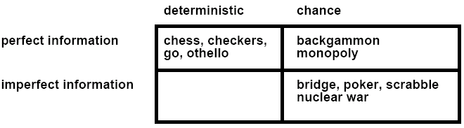
Types of Games

Slide 6
Game setup
Two players: MAX and MIN
MAX moves first and they take turns until the game is over. Winner gets award, looser gets penalty.
Games as search:
Initial state: e.g. board configuration of chess
Successor function: list of (move,state) pairs specifying legal moves.
Terminal test: Is the game finished?
Utility function: Gives numerical value of terminal states. E.g. win (+1), loose (-1) and draw (0) in tic-tac-toe (next)
MAX uses search tree to determine next move.

Slide 7
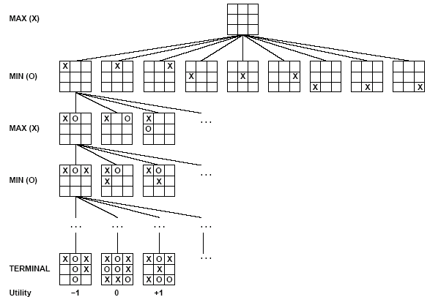
Partial Game Tree for Tic-Tac-Toe

Slide 8
Optimal strategies
Find the contingent strategy for MAX assuming an infallible MIN opponent.
Assumption: Both players play optimally !!
Given a game tree, the optimal strategy can be determined by using the minimax value of each node:
MINIMAX-VALUE(n)=
UTILITY(n) If n is a terminal
max_{s ∈ successors(n)} MINIMAX-VALUE(s) If n is a max node
min_{s ∈ successors(n)} MINIMAX-VALUE(s) If n is a min node

Slide 9
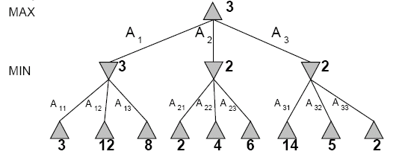
Two-Ply Game Tree
Original Slides by Tom Lenaerts – IRIDIA ULB
Adapted for Edinburgh Napier by Ben Paechter

Slide 10
Two-Ply Game Tree

Slide 11
Two-Ply Game Tree

Slide 12
Two-Ply Game Tree
The minimax decision
Minimax maximizes the worst-case outcome for max.

Slide 13
What if MIN does not play optimally?
Definition of optimal play for MAX assumes MIN plays optimally: maximizes worst-case outcome for MAX.
But if MIN does not play optimally, MAX will do even better. [Can be proved.]

Slide 14
Minimax Algorithm
function MINIMAX-DECISION(state) returns an action
inputs: state, current state in game
v←MAX-VALUE(state)
return the action in SUCCESSORS(state) with value v
function MAX-VALUE(state) returns a utility value
if TERMINAL-TEST(state) then return UTILITY(state)
v ← - ∞
for a,s in SUCCESSORS(state) do
v ← MAX(v,MIN-VALUE(s))
return v
function MIN-VALUE(state) returns a utility value
if TERMINAL-TEST(state) then return UTILITY(state)
v ← ∞
for a,s in SUCCESSORS(state) do
v ← MIN(v,MAX-VALUE(s))
return v

Slide 15
Properties of Minimax
Criterion | Minimax
Complete? | Yes
Time | O(b^{m})
Space | O(bm)
Optimal? | Yes
☺
b - maximum branching factor of the search tree
m – maximum depth
☹
☺
☺

Slide 16
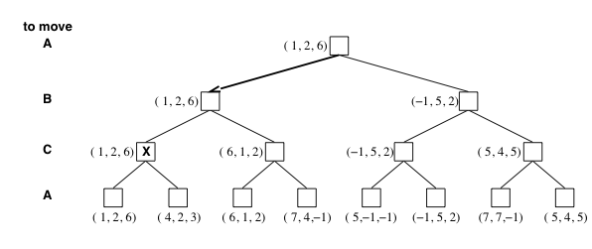
Multiplayer games
Games allow more than two players
Single minimax values become vectors

Slide 17
Problem of minimax search
Number of games states is exponential to the number of moves.
Solution: Do not examine every node
==> Alpha-beta pruning
Alpha = value of best choice found so far at any choice point along the MAX path
Beta = value of best choice found so far at any choice point along the MIN path
Revisit example …

Slide 18
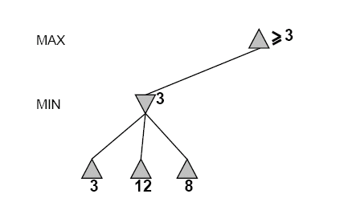
Alpha-Beta Example
Do DF-search until first leaf
Range of possible values
[-∞,+∞]
[-∞, +∞]

Slide 19
Alpha-Beta Example (continued)
[-∞,+∞]
[-∞,3]

Slide 20
Alpha-Beta Example (continued)
[-∞,+∞]
[-∞,3]

Slide 21
Alpha-Beta Example (continued)
[3,+∞]
[3,3]

Slide 22
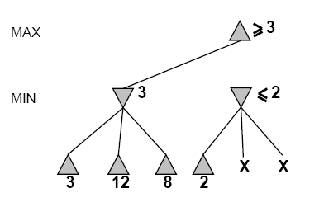
Alpha-Beta Example (continued)
[3,+∞]
This node is worse
for MAX
[3,3]
[-∞,2]

Slide 23
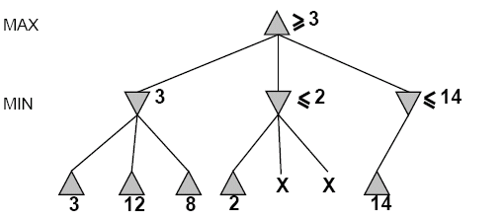
Alpha-Beta Example (continued)
[3,14]
,
[3,3]
[-∞,2]
[-∞,14]

Slide 24
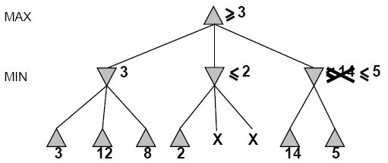

Alpha-Beta Example (continued)
[3,5]
,
[3,3]
[−∞,2]
[-∞,5]

Slide 25
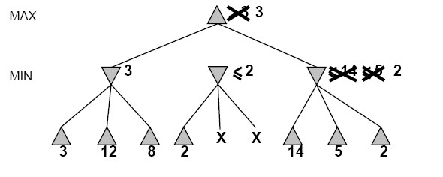
Alpha-Beta Example (continued)
[3,3]
[3,3]
[−∞,2]
[2,2]

Slide 26
Alpha-Beta Example (continued)
[3,3]
[3,3]
[-∞,2]
[2,2]

Slide 27
Alpha-Beta Algorithm
function ALPHA-BETA-SEARCH(state) returns an action
inputs: state, current state in game
v←MAX-VALUE(state, - ∞ , +∞)
return the action in SUCCESSORS(state) with value v
function MAX-VALUE(state,α , β) returns a utility value
if TERMINAL-TEST(state) then return UTILITY(state)
v ← - ∞
for a,s in SUCCESSORS(state) do
v ← MAX(v,MIN-VALUE(s, α , β))
if v ≥ β then return v
α ← MAX(α ,v)
return v

Slide 28
Alpha-Beta Algorithm
function MIN-VALUE(state, α , β) returns a utility value
if TERMINAL-TEST(state) then return UTILITY(state)
v ← + ∞
for a,s in SUCCESSORS(state) do
v ← MIN(v,MAX-VALUE(s, α , β))
if v ≤ α then return v
β ← MIN(β ,v)
return v

Slide 29
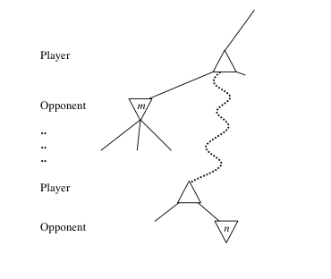
General alpha-beta pruning
Consider a node n somewhere in the tree
If player has a better choice at
Parent node of n
Or any choice point further up
n will never be reached in actual play.
Hence when enough is known about n, it can be pruned.

Slide 30
Final Comments about Alpha-Beta Pruning
Pruning does not affect final results
Entire subtrees can be pruned.
Good move ordering improves effectiveness of pruning
With “perfect ordering,” time complexity is O(b^{m/2})
Branching factor of sqrt(b) !!
Alpha-beta pruning can look twice as far as minimax in the same amount of time

Slide 31
Games of imperfect information
Minimax and alpha-beta pruning require too many leaf-node evaluations.
May be impractical within a reasonable amount of time.
Shannon (1950):
Cut off search earlier (replace TERMINAL-TEST by CUTOFF-TEST)
Apply heuristic evaluation function EVAL (replacing utility function of alpha-beta)

Slide 32
Cutting off search
Change:
if TERMINAL-TEST(state) then return UTILITY(state)
into
if CUTOFF-TEST(state,depth) then return EVAL(state)
Introduces a fixed-depth limit depth
Is selected so that the amount of time will not exceed what the rules of the game allow.
When cuttoff occurs, the evaluation is performed.

Slide 33
Heuristic EVAL
Idea: produce an estimate of the expected utility of the game from a given position.
Performance depends on quality of EVAL.
Requirements:
EVAL should order terminal-nodes in the same way as UTILITY.
Computation may not take too long.
For non-terminal states the EVAL should be strongly correlated with the actual chance of winning.

Slide 34
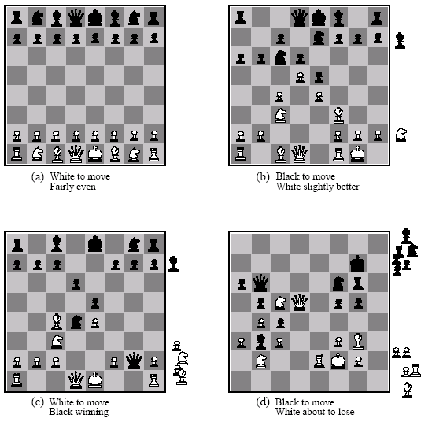
Heuristic EVAL example
Eval(s) = w₁ f₁(s) + w₂ f₂(s) + … + w_{n}f_{n}(s)

Slide 35
Heuristic EVAL example
Addition assumes
independence
Eval(s) = w₁ f₁(s) + w₂ f₂(s) + … + w_{n}f_{n}(s)

Slide 36
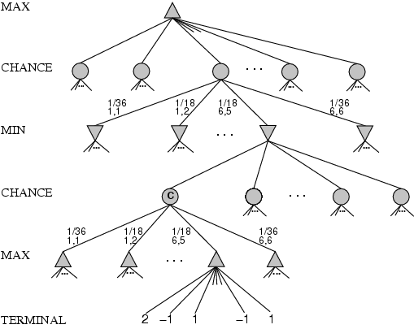
Games that include chance
chance nodes

Slide 37
Expected minimax value
EXPECTED-MINIMAX-VALUE(n)=
UTILITY(n) If n is a terminal
max_{s ∈ successors(n)} MINIMAX-VALUE(s) If n is a max node
min_{s ∈ successors(n)} MINIMAX-VALUE(s) If n is a max node
∑_{s ∈ successors(n)} P(s) . EXPECTEDMINIMAX(s) If n is a chance node
These equations can be backed-up recursively all the way to the root of the game tree.

